Slide 1
Indian Muslims Association of Greater Houston
Fostering Amity Across Cultures, Communities, and Religions

Slide 2
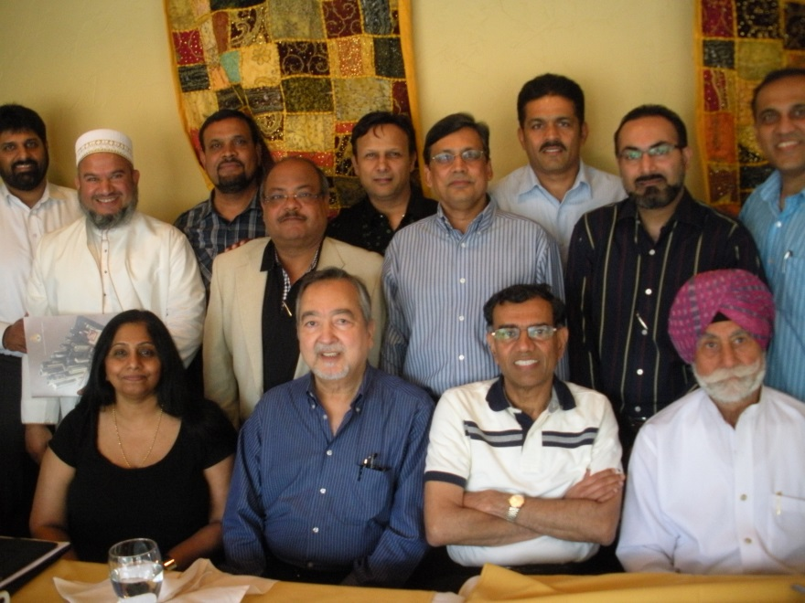
About IMAGH
Est. 2012
Non Profit, Non Political and Non Religious Organization
Groom Future Leaders among youth
SAYA & CLUB65
Platform for both young and seniors to contribute to the society across Greater Houston Region
MISSION: Fostering Amity Across Cultures, Communities, and Religions

Slide 3
Objectives
300+ Members
Promote Indian Muslim Culture
Promote social and cultural responsibilities among youth of the community
Promote and support educational opportunities to needy students
Develop and Strengthen the Indian Muslim Identity
To foster social interaction between the senior citizens and the youth of the community
Organize and celebrate Muslim festivals in association with other organizations

Slide 4
Planned Activities
Eid Milan
Family Fun Day
Community Outreach
Senior Citizen Events (CLUB65)
Young Adult Events (SAYA)
Annual Picnic

Slide 5
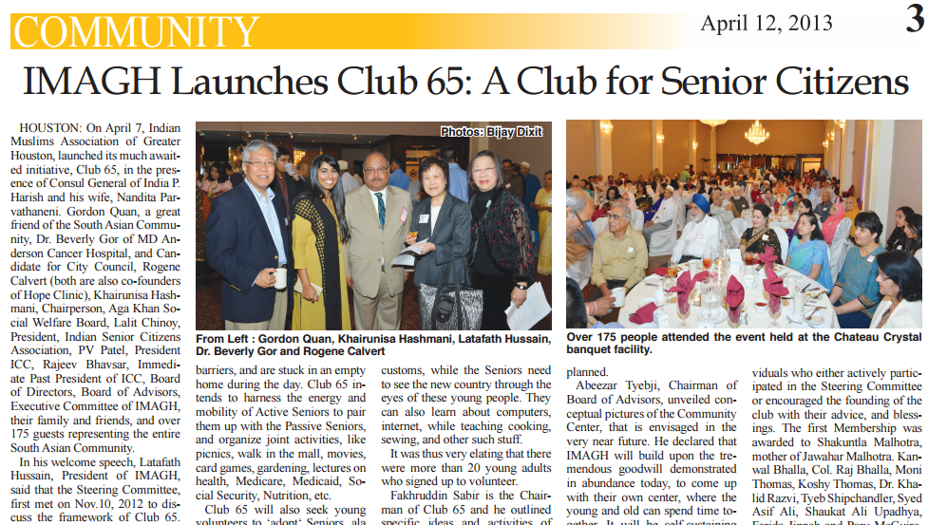
Inauguration of CLUB 65 April 7, 2013

Slide 6
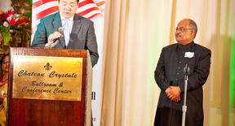
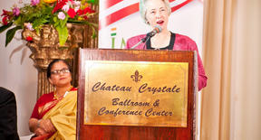
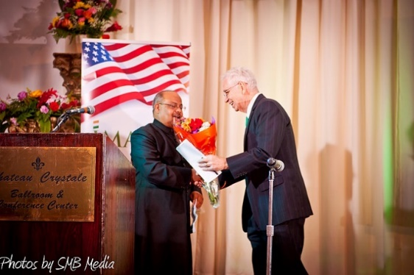
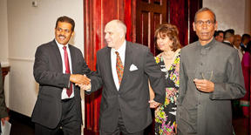
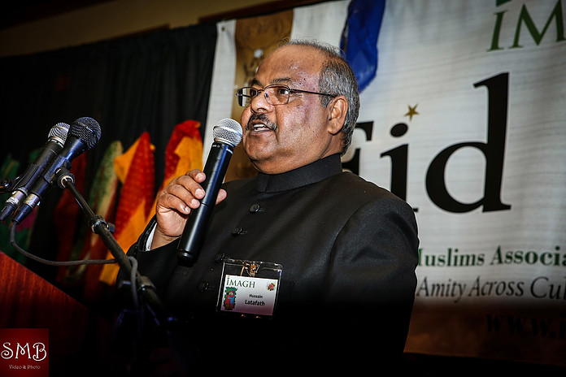
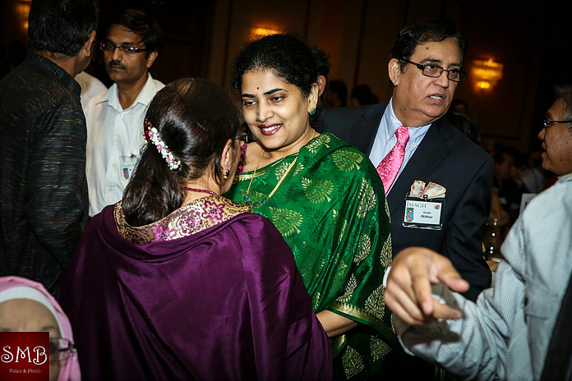
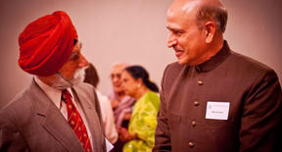
Eid Milan 2013

Slide 7
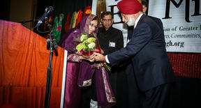
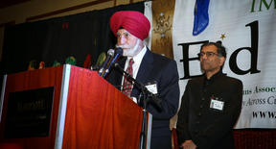
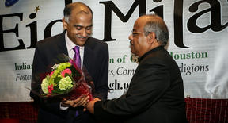
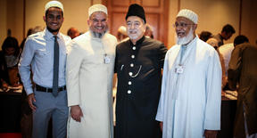
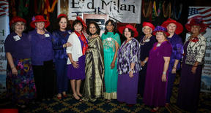
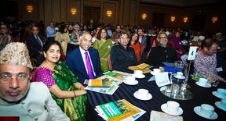
Eid Milan 2014

Slide 8
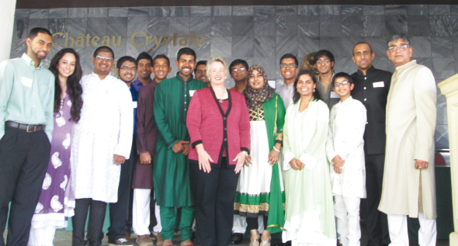
Inauguration of SAYA April 27, 2014

Slide 9
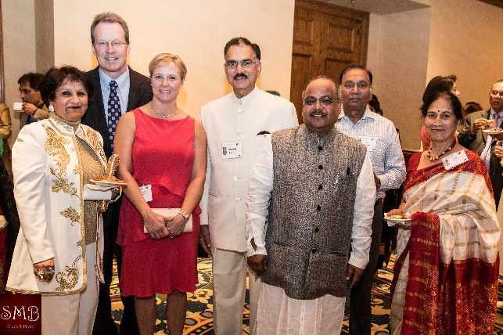
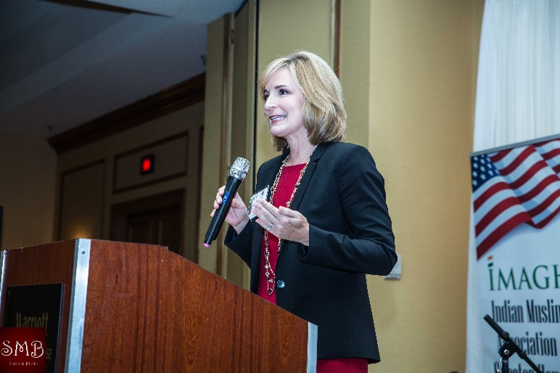
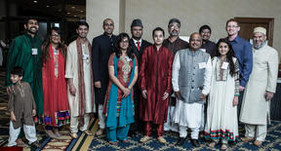
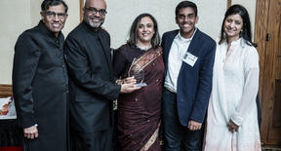
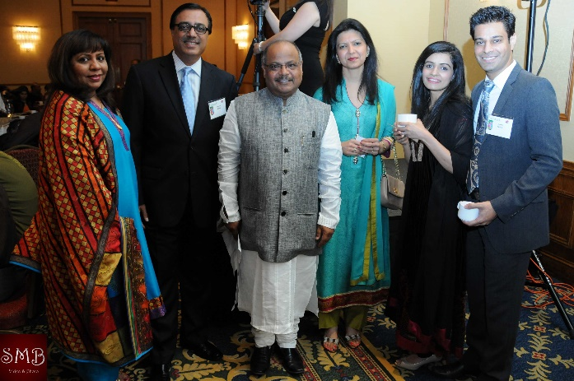
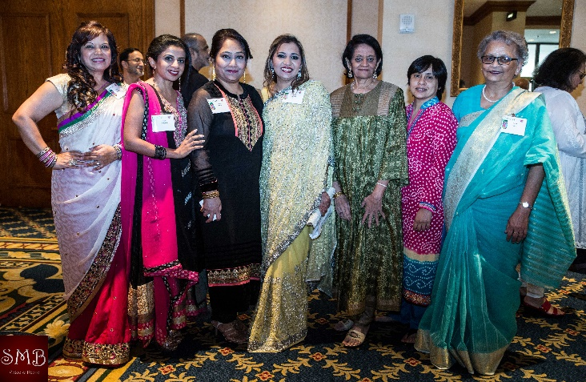
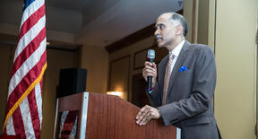
Eid Milan 2015

Slide 10
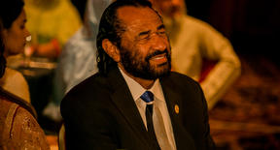
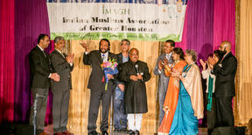
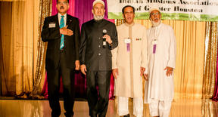
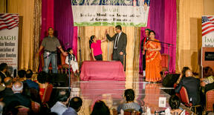
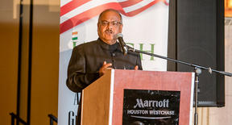
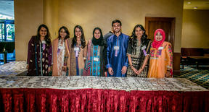
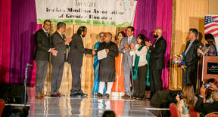
Eid Milan 2016

Slide 11
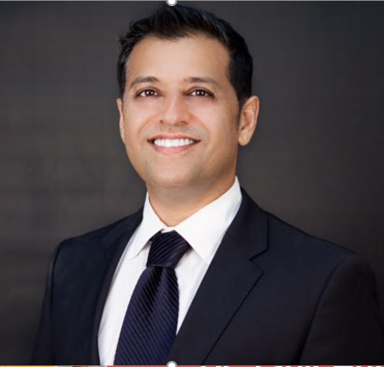
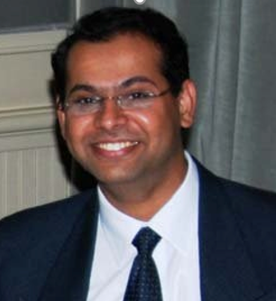
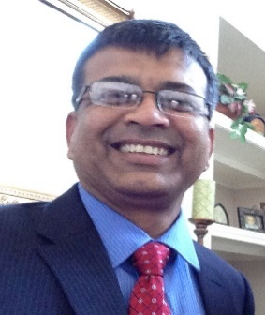
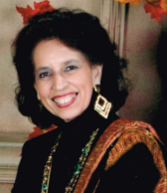
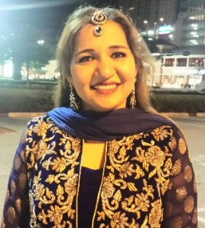
Leadership – Executive Team – 2017-18
Ibrahim Munir
Rahat Kalle
Parvin Saiyed
Dr. Yunus Langha
Saeed Pathan

Slide 12
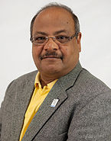
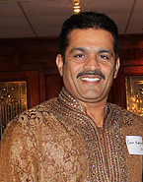
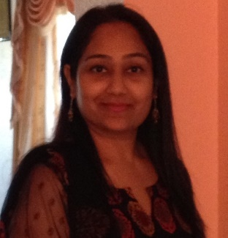
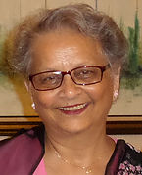
Leadership – Executive Team - Past
Latafath Hussein
Ismet Warsi
Parvin Saiyed
Karim Maknojia
Shaheen Vora

Slide 13
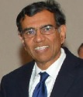
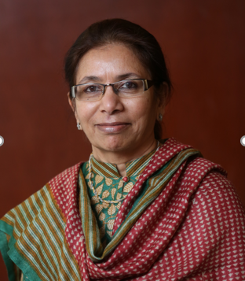
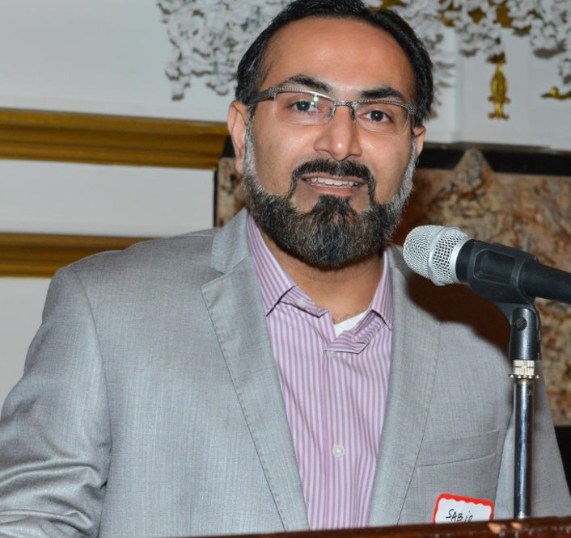
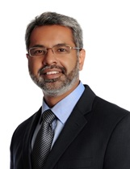
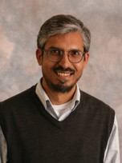
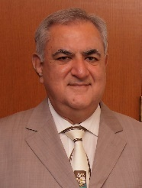
Leadership – Board of Directors
Dr. Maqbool Haq
Dr. Salman Mirza Baig
Dr. Tahir Hussain
Fakhruddin Sabir
Dr. Saleha Khumawala
Fateh Ali Chatur

Slide 14
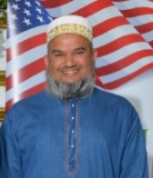
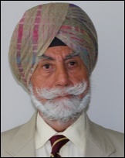
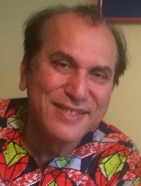
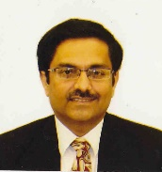
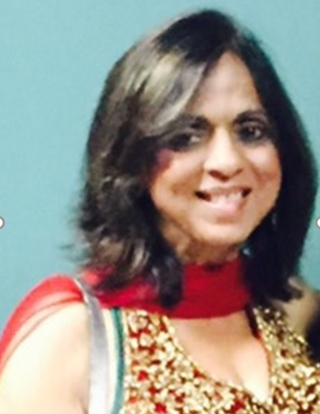
Leadership – Board of Advisors
Abeezar Tyebji
Rajneesh Chaudhary
Paru McGuire
Jawahar Malhotra
Angeli Arjunani
Col. Raj Bhalla

Slide 15
Thank you!!!

